Slide 1
C# INTRODUCTION

Slide 2
C# OVERVIEW
C# (pronounced “C-Sharp”) is a modern, general-purpose, object-oriented programming language developed by Microsoft in 2000 as part of its .Net, which aimed to create a unified platform for building a wide range of applications.
C# is a high-level, object-oriented programming language that is designed for building a wide range of applications.
C# is frequently used for Windows application, Web Application, Game Development, Mobile Apps and Cloud-based Services.
It runs on the .Net platform and combines the productivity of rapid application development languages with the power of more complex languages like C++.

Slide 3
KEY CHARACTERISTICS OF C#
1. Object-Oriented
C# is fully object-oriented, meaning everything revolves around classes and objects.
Supports inheritance, polymorphism, encapsulation, and abstraction.
2. Modern and General-Purpose
C# was designed to be modern, keeping up with programming trends.
General-purpose: Can be used for Windows apps, web apps, mobile apps, games, and cloud services.
3. Type-Safe
C# is a strongly typed language, which prevents type errors at compile time.
Example: You cannot store a string in an integer variable without conversion.

Slide 4
4. Component-Oriented
C# is a component-oriented language, which means it supports building reusable, self-contained pieces of code called components.
Each component performs a specific function and can be easily combined, replaced, or reused in different applications.
5. Part of .NET Framework
Runs on the .NET platform, which provides:
  Memory management (garbage collection)
  Security
  Cross-language integration
  Pre-built libraries for common tasks
6. Interoperable
C# is an interoperable language, which means it can interact and work with code written in other programming languages such as C++, VB.NET.
This allows developers to reuse existing code and integrate legacy systems without rewriting everything from scratch

Slide 5
7. Scalable and Updatable
C# is designed to build applications that are scalable (able to handle increasing loads or users) and easily updatable (can be maintained and improved without major changes).
This makes C# suitable for everything from small desktop apps to large enterprise or cloud-based solutions.
8. Automatic Memory Management
C# uses an automatic memory management system through a process called Garbage Collection (GC).
This means developers don’t have to manually allocate or free memory, as the .NET runtime automatically handles it.
9. Rich Library Support
C# provides rich library support through the .NET Class Library, which contains thousands of pre-built classes, methods, and components.
These libraries help developers perform common tasks — such as file handling, database access, networking, XML processing, and much more — without writing code from scratch

Slide 6
Feature | Description | Example / Explanation | Benefit
1. Type-Safe | C# is a strongly typed language that prevents type errors at compile time. | You cannot store a string in an integer variable without conversion. | Ensures data correctness and reduces runtime errors.
2. Component-Oriented | Supports building reusable, modular components like classes, DLLs, and APIs. | Example: Creating an Email Sender class and reusing it across projects. | Promotes reusability and simplifies maintenance.
3. Interoperable | C# can interact with other languages (e.g., C++, VB.NET, COM). | Using Dll Import to call C++ functions from C#. | Enables integration with existing legacy systems.
4. Scalable & Updatable | Easily scales from small apps to large enterprise solutions. | Supports async/await, multi-threading, and modular architecture. | Improves performance, flexibility, and maintainability.
5. Automatic Memory Management | Uses Garbage Collection to free unused memory automatically. | Developers don’t need to manually use free() or delete. | Prevents memory leaks and improves reliability.
6. Rich Library Support | Provides access to the .NET Class Library with thousands of pre-built classes. | Example: Using System.IO for file handling. | Speeds up development and ensures reliability.

Slide 7
WHY C#
Advantages of C#
  C# offers a wide range of advantages that makes it a preferred language for developers in various industries.
1. Ease of Use
C# has a simple and modern syntax, similar to Java and C++, making it easy to learn for beginners.
Object-oriented programming concepts (classes, objects) are well-integrated, making code organized and readable.
Automatic Memory Management: Through Garbage collection, C# manages memory automatically, freeing up unused objects and reducing the chances of memory leaks.
2. Productivity
C# provides rich libraries (Base Class Library, .NET) that save development time. It provide developers with pre-build functions for a wide range of tasks like file handling, string manipulation, networking and more..
Tools like Visual Studio and Visual Studio Code offer intelligent code completion, debugging, and templates.

Slide 8
3. Cross-Platform Development
With .NET Core / .NET 5+, C# can run on Windows, Linux, macOS, mobile, and cloud platforms.
Frameworks like Xamarin and MAUI allow building mobile apps for Android and iOS using the same C# codebase.
ASP.NET Core allows web applications to run cross-platform.
4. High Performance
C# uses Just-In-Time (JIT) compilation to convert code into native machine code at runtime.
Optimizations like asynchronous programming (async/await) and efficient memory management improve application performance.
Supports multi-threading and parallel processing for faster execution of complex tasks.

Slide 9
5. Security
C# runs on the Common Language Runtime (CLR) which enforces:
  Type safety: Prevents invalid type conversions and runtime errors.
  Code access security: Restricts unauthorized access to system resources.
  Exception handling: Safely manages errors without crashing the application.
Ideal for enterprise applications where data protection is critical.

Slide 10
C# APPLICATION
Application Type | Description | Examples
Desktop Applications | Traditional desktop apps with GUI | Paint.NET, KeePass, Visual Studio extensions
Web Applications | Dynamic websites and web services using ASP.NET / ASP.NET Core | Stack Overflow, DotNetNuke, E-commerce Web APIs
Mobile Applications | Cross-platform apps using Xamarin / .NET MAUI | Alaska Airlines app, Olo, Storyo
Game Development | Games built with Unity engine using C# scripting | Monument Valley, Pokémon Go, Hollow Knight
Enterprise & Business Software | ERP, CRM, Accounting systems for businesses | Microsoft Dynamics 365, POS systems
Cloud-Based Applications | Backend services and microservices on Azure | Web APIs in Azure App Services, Cloud microservices
IoT Applications | Embedded and Internet-of-Things apps | Smart home controllers, Industrial monitoring software
AI & Machine Learning Apps | Applications using ML.NET for predictive analytics and AI models | Recommendation engines, Business analytics apps

Slide 11
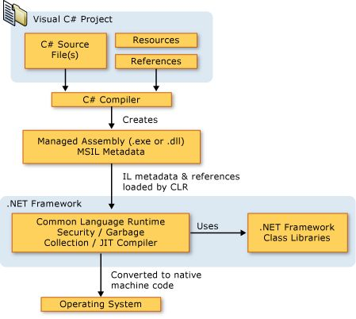
VISUAL OF C#

Slide 12
COMMON LANGUAGE RUNTIME (CLR)

Slide 13
WHAT IS CLR?
The CLR is the heart of .NET, providing runtime execution, memory management, security, and cross-language support.
It allows developers to write safe, scalable, and high-performance applications without worrying about low-level details.
You can think of it as the engine that runs C#, VB.NET, F#, or any other .NET language.
It functions as a virtual machine that handles the execution and management of .NET applications.

Slide 14
KEY RESPONSIBILITIES OF CLR
CLR performs multiple tasks behind the scenes:
a) Memory Management
Automatically manages memory allocation and deallocation.
Uses a process called Garbage Collection (GC) to free memory from objects no longer in use.
Reduces memory leaks and makes programming easier.
b) Type Safety
Ensures that objects are used in a way that is consistent with their type definitions.
Prevents type mismatch errors, such as trying to store a string in an integer variable.
c) Exception Handling
Provides a structured way to handle runtime errors through try-catch-finally blocks.
Ensures that programs fail gracefully instead of crashing.

Slide 15
d) Security
CLR enforces Code Access Security (CAS) to control what code can do.
Prevents unsafe code from performing harmful operations like accessing files or memory arbitrarily.
e) Interoperability
Allows .NET applications to interact with COM objects and native Windows APIs.
Makes it possible to use existing libraries or components outside .NET.
f) Thread Management and Concurrency
Manages multiple threads efficiently.
Supports multi-threading, allowing applications to run tasks in parallel.

Slide 16
g) Just-In-Time Compilation (JIT)
Converts MSIL (Microsoft Intermediate Language) code into native machine code at runtime.
Ensures that .NET code runs efficiently on any supported platform.
h) Code Verification
Verifies that code meets certain rules before execution.
Helps prevent runtime errors and improves security.

Slide 17
CLR ARCHITECTURE
CLR consists of several components that work together:
Class Loader
  Loads .NET classes into memory.
MSIL Code Execution Engine
  Executes Microsoft Intermediate Language (MSIL) code.
JIT Compiler
  Converts MSIL to native code (machine-level instructions) just before execution.
Garbage Collector
  Automatically frees unused memory.
Security Engine
  Enforces role-based and code access security.
Exception Handling Mechanism
  Manages runtime exceptions.
Thread Management
  Manages threads, synchronization, and execution order.

Slide 18
HOW CLR WORKS: STEP BY STEP
Here’s what happens when a .NET program runs:
Code Compilation:
  Developer writes C# or VB.NET code.
  Compiler converts it into MSIL and generates metadata.
Class Loading:
  CLR loads assemblies and classes into memory.
JIT Compilation:
  MSIL is converted to native machine code just-in-time before execution.
Execution & Management:
  CLR manages memory, security, threads, and exceptions during runtime.
  Garbage Collector automatically cleans unused objects.
Program Execution:
  The native code is executed by the CPU efficiently.

Slide 19
COMMON TYPE SYSTEM(CTS)

Slide 20
CTS OVERVIEW
The Common Type System (CTS) is a fundamental part of the .NET Framework and .NET Core/5+ architecture.
It defines how data types are declared, used, and managed by the Common Language Runtime (CLR).
Its main goal is to provide a common standard for defining and using data types across multiple .NET languages — like C#, VB.NET, F#, etc.
Because of CTS, language interoperability is possible — meaning code written in one .NET language can interact seamlessly with another.

Slide 21
PURPOSE OF CTS
Language Interoperability:
Ensures that all .NET languages share a common understanding of data types.
Type Safety:
Prevents type mismatches (for example, mixing incompatible data types).
Performance Optimization:
By defining how data types are represented and stored in memory, the CLR can efficiently manage resources.
Cross-language Compatibility:
A class created in C# can be inherited in VB.NET.

Slide 22
CATEGORIES OF CTS TYPES
The Common Type System (CTS) in .NET categorizes all data types into two main categories:
Categories of CTS Types
1. Value Types
Definition:
  Value types store the actual data directly in memory (usually on the stack).
  When a value type variable is assigned to another, a copy of the value is created — not a reference.
      Key Characteristics:
        Contain actual data.
        Stored on the stack (faster access).
        Independent copies — changes to one do not affect the other.
        Inherit from: System.ValueType

Slide 23
Examples:
  Built-in types: int, float, char, bool
  User-defined types: struct, enum
2. Reference Types
Definition:
  Reference types store a reference (memory address) to the actual data, which is kept on the heap.
  When a reference type variable is assigned to another, both variables refer to the same object in memory.
Key Characteristics:
  Contain memory addresses, not actual data.
  Stored on the heap.
  Multiple variables can refer to the same object.
  Inherit from: System.Object
      Examples:
        Class
        Interface
        Array
        Delegate
        String

Slide 24
MODEL, VIEW,CONTROLLER

Slide 25
WHAT IS MVC?
The Framework is an architectural/design pattern that separates an application into three main logical components Model, View, and Controller.
Each architectural component is built to handle specific development aspects of an application.
It isolates the business logic and presentation layer from each other. It was traditionally used for desktop Graphical User Interfaces (GUIS).
The main goal of this design pattern was to solve the problem of users controlling a large and complex data set by splitting a large application into specific sections that all have their own purpose.

Slide 26
FEATURES OF MVC
It provides a clear separation of business logic, UI logic, and input logic.
It offers full control over your html and urls which makes it easy to design web application architecture.
It is a powerful url-mapping component using which we can build applications that have comprehensible and searchable urls.
It supports Test Driven Development (TDD).

Slide 27
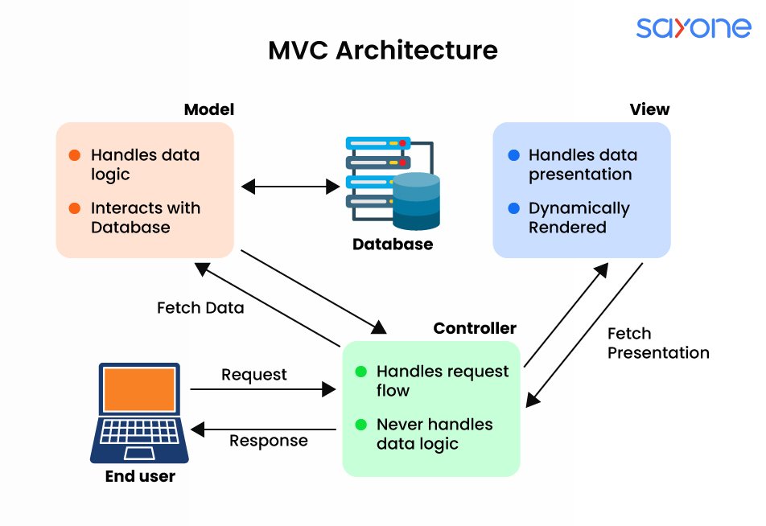
MVC ARCHITECTURE

Slide 28
CONTROLLER
The controller acts as an intermediary between the model and the view.
It receives input from the user, communicates with the model to perform the necessary actions, and then updates the view with the new data.
The controller does not handle data storage or business logic; it simply coordinates the interaction between the model and the view.
Responsibilities:
  Receiving user input and interpreting it.
  Updating the Model based on user actions.
  Selecting and displaying the appropriate View.

Slide 29
VIEW
The view component is used for all the UI logic of the application. It generates a user interface for the user.
Views are created by the data which is collected by the model component but these data aren’t taken directly but through the controller. It only interacts with the controller.
Responsibilities:
  Rendering data to the user in a specific format.
  Displaying the user interface elements.
  Updating the display when the Model changes.

Slide 30
MODEL
The model component corresponds to all the data-related logic that the user works with. This can represent either the data that is being transferred between the view and controller components or any other business logic-related data.
It can add or retrieve data from the database. It responds to the controller's request because the controller can't interact with the database by itself.
The model interacts with the database and gives the required data back to the controller.
Responsibilities:
  Managing data: CRUD (Create, Read, Update, Delete) operations.
  Enforcing business rules.
  Notifying the View and Controller of state changes.

Slide 31
ADVANTAGES OF MVC
Codes are easy to maintain and they can be extended easily.
The mvc model component can be tested separately.
The components of mvc can be developed simultaneously.
It reduces complexity by dividing an application into three units. Model, view, and controller.
It supports Test Driven Development (TDD).
It works well for web apps that are supported by large teams of web designers and developers.
This architecture helps to test components independently as all classes and objects are independent of each other
Search Engine Optimization (SEO) friendly.

Slide 32
DISADVANTAGES OF MVC
It is difficult to read, change, test, and reuse this model
It is not suitable for building small applications.
The inefficiency of data access in view.
The framework navigation can be complex as it introduces new layers of abstraction which requires users to adapt to the decomposition criteria of mvc.
Increased complexity and inefficiency of data

Slide 33
LANAGUAGE INTEGRATED QUERY (LINQ)

Slide 34
WHAT IS LINQ?
LINQ(Language Integrated Query) originated in C# 3.0 & .NET framework 3.5
LINQ offers the best way to change the data, whether to or from the database with the XML file or with the list of the dynamic data. It is the uniform query system in the C# for retrieving the data from various sources of formats and data.
It is incorporated with the C# for deleting the mismatch between the database and programming language. It offers single query interfaces for different data sources.
For instance, SQL is the Structured Query Language that we use for saving and retrieving data from the database. In the same way. LINQ is the Structured Query Syntax. LINQ is developed in the C#. We use it for retrieving the data from different data sources like docs, XML, collections, MS SQL Server, ADO.Net Dataset, Web Service, etc.

Slide 35
WHY LINQ
If we are working on the SQL server. For working on the SQL server, we have to learn the syntax of SQL server and sql-associated ADO.NET objects.
After that, we can switch to oracle database; thus, we have to grasp command on the oracle syntax and oracle ADO.NET objects for working with the C#. This problem comes with all the technologies we use.
In this case, we have to learn all these languages. Therefore, to avoid this problem, Microsoft introduced LINQ.
In the LINQ, we not only work with the famous collections from the database but will work with other data sources like an XML file, memory-data table, etc. We can utilize LINQ queries in two different ways:
  Method Syntax
  Query Syntax

Slide 36
Query syntax: it is similar to SQL and is often more readable for those familiar with SQL. It starts with a from clause followed by a range variable and includes standard query operations like where, select, group, join, etc.
Method syntax (fluent syntax): it uses extension methods and lambda expressions. It can be more concise and is preferred when writing complex queries because it can be easier to read and compose.

Slide 37
ADVANTAGES OF LINQ
We do not have to master the latest query language syntaxes for many data sources as it offers the standard query syntax for many data sources.
In linq, we need to write less code than the conventional methodology. Through LINQ, we can reduce the code.
Linq offers compile-time error checking and intelligence support in visual studio. This feature allows us to evade run-time errors.
Linq offers various in-built methods that we can use to carry out different operations like ordering, filtering, grouping, etc.
We can reuse the linq queries

Slide 38
DISADVANTAGES OF LINQ
Through LINQ, it is difficult to write complex queries like SQL.
It was developed in the code, and we cannot use the cache execution plan, which is the feature of SQL like we do in the stored procedures.
If the query is not written correctly, then performance can be degraded.
If we make some modifications to the queries, then we have to recompile the application and redeploy the dll file to the server.

Slide 39
WHY SHOULD WE LEARN LINQ?
Let us understand why we should learn LINQ with an example. Suppose we are developing a .NET application that requires data from different sources.
The application needs data from the sql server database. So, as a developer, to access the data from the SQL server database, we need to understand ADO.NET and SQL server-specific syntaxes. We need to learn SQL syntax specific to oracle database if the database is oracle.
The application also needs data from an xml document. So, as a developer, to work with XML documents, we need to understand xpath and XSLT queries.
The application also needs to manipulate the data (objects) in memory, such as list<products>, list<orders>, etc. So, as a developer, we should also understand how to work with in-memory objects.

Slide 40
WORKFLOW OF LINQ?
Data Source Selection:
  Identify the data source you want to query. This could be a collection, array, database, XML document, or another LINQ-compatible data source.
Data Source Access:
  Access the data source using the appropriate LINQ provider. For example, LINQ to Objects is used for in-memory collections, LINQ to SQL for databases, and LINQ to XML for XML documents.
Query Construction:
  Construct a LINQ query using the standard query operators and syntax provided by LINQ. Define the criteria for selecting, filtering, sorting, or grouping data.
Deferred Execution:
  Keep in mind that LINQ queries are lazily executed, meaning they are not executed until the results are needed. This allows for efficient query optimization.

Slide 41
5. Query Execution:
  Execute the query to obtain the results. The execution can happen implicitly when iterating over the results or explicitly by using methods like ToList(), ToArray(), or FirstOrDefault().
6. Result Processing:
  Process and use the results of the query according to your application’s requirements. This could involve further transformations, data binding, or presenting the data to users.
7. Error Handling:
  Handle exceptions or errors that may occur during query execution, such as database connection issues, data format errors, or null references.
8. Optimization:
  Consider optimizing your queries for performance, especially when dealing with large datasets. This might involve using appropriate indexing, caching, or parallel execution where applicable.
9. Integration with Application Logic:
  Integrate the LINQ queries seamlessly into your application’s logic, ensuring that the queried data is used effectively to achieve the desired functionality.

Slide 42
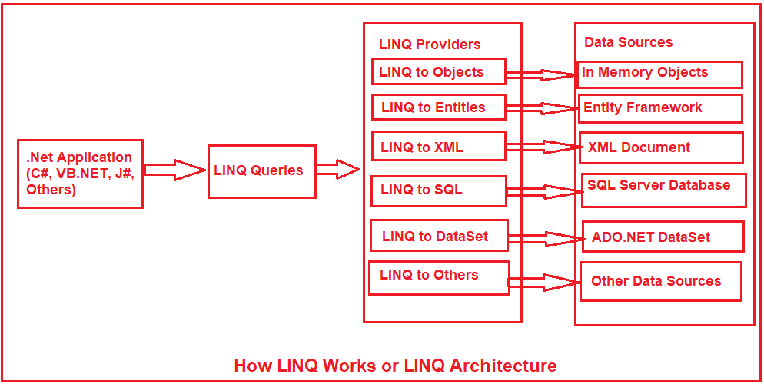
LINQ ARCHITECTURE

Slide 43
LINQ ARCHITECTURE
It provides a layered architecture that separates query syntax from data source implementation, enabling a unified approach to querying data.
          Query Expressions.
          Query Providers.
          Standard Query Operators (SQO)
          Expression Trees

Slide 44
1. Query Expressions:
  LINQ queries are written in a syntax similar to C# or VB.NET expressions, making them intuitive and easy to understand.
  These expressions specify the data source to query, the data to retrieve, and any filtering or transformations to apply.
  Developers write these queries using familiar keywords like from, where, and select.
2. Query Providers:
  Different types of data sources (e.g., in-memory collections, databases, XML documents) require different approaches for querying.
  LINQ provides built-in provider implementations for common data sources (e.g., Enumerable for in-memory collections, LinqToObjects for objects, LinqToXml for XML).
  Custom providers can be developed to integrate LINQ with other data sources.

Slide 45
3. Standard Query Operators (SQO):
  They are a set of predefined methods such as Where(), Select(), and OrderBy() used to perform operations on data sources.
  These methods form the core API of LINQ, enabling powerful data manipulation and querying.
  They support deferred execution and allow functional-style querying for efficient and flexible data handling.
4. Expression Trees:
  LINQ queries are translated into internal representation called expression trees.
  These trees capture the logic of the query, including data source, filters, and transformations.
  The query provider then utilizes the expression tree to navigate and manipulate the specific data source efficiently.

Slide 46
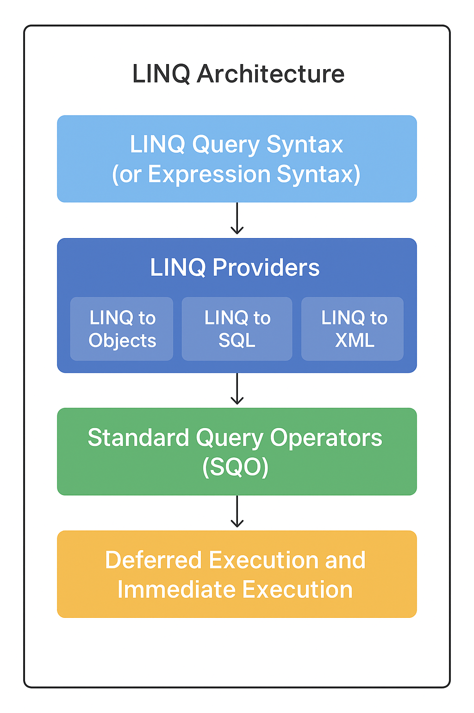

Slide 47
QUERY SYNTAX
Query Syntax is similar to SQL and is often more readable for those familiar with SQL. It starts with a from clause followed by a range variable and includes standard query operations like where, select, group, join, etc.
Key Points:
Query syntax is more readable and SQL-like.
Internally, it gets converted to method syntax (using lambda expressions).
You can use it with arrays, lists, XML, databases, etc.

Slide 48
EXPLANATION OF CLAUSES:
Clause | Description
from | Specifies the data source and introduces a range variable (like a table alias in SQL).
where | Filters data based on a condition (similar to SQL WHERE).
select | Projects or returns the result (like SQL SELECT).
orderby | Sorts the data (like SQL ORDER BY).
group | Groups data (like SQL GROUP BY).
join | Joins two data sources (like SQL JOIN).

Slide 49
ADVANTAGES AND LIMITATION
ADVANTAGES OF QUERY SYNTAX
Easy to read and understand (especially for SQL users).
Great for simple filtering, sorting, and grouping.
Works well with complex queries involving joins and grouping.
LIMITATIONS:
Limited in supporting all advanced LINQ methods (like Sum, Average, Count).
For some operations, you must switch to method syntax

Slide 50
METHOD SYNTAX
Method Syntax (also called Fluent Syntax or Lambda Syntax) uses extension methods and lambda expressions to perform queries on data collections.
It’s often more concise, powerful, and flexible than query syntax — especially for complex filtering, grouping, or aggregation.

Slide 51
EXPLANATION OF COMPONENT:
Component | Description
Extension Methods | Methods added to existing types (like arrays or lists) without modifying their source code — e.g., Where(), Select(), OrderBy().
Lambda Expressions | Short functions used to define conditions or transformations. Example: n => n > 10 means “for each element n, check if it’s greater than 10.”

Slide 52
COMPARISON BETWEEN QUERY SYNTAX AND METHOD SYNTAX IN LINQ
Aspect | Query Syntax | Method Syntax
Definition | SQL-like declarative style for writing LINQ queries. | Uses extension methods and lambda expressions to perform operations.
Style / Look | Similar to SQL (SELECT, WHERE, FROM). | Functional / Fluent style with method chaining (Where(), Select()).
Syntax Example | from s in students where s.Marks > 50 select s; | students.Where(s => s.Marks > 50);
Based On | Query comprehension model (compiler converts to methods). | Uses extension methods directly (like Where(), Select()).
Readability | Easier for beginners or SQL users (more human-readable). | Easier for developers familiar with C# functions and lambdas.

Slide 53
Aspect | Query Syntax | Method Syntax
Flexibility | Suitable for simple filtering, grouping, or selecting data. | Better for complex queries (aggregations, joins, nested operations).
Use of Lambda | Optional (not directly used in syntax). | Mandatory (core part of expression).
Compiler Conversion | Internally converted into method syntax by compiler. | Already written in method syntax (no conversion).
Chaining Methods | Limited chaining support. | Full method chaining supported (Where().Select().OrderBy() etc.).
Performance | Same as method syntax (both compiled to same IL code). | Same as query syntax.
Example Output | Both produce the same result. | Both produce the same result.

Slide 54
VARIABLLES, DATA TYPES

Slide 55
VARIABLES
Variables are containers for storing data values.
In C#, there are different types of variables (defined with different keywords), for example:
int - stores integers (whole numbers), without decimals, such as 123 or -123
double - stores floating point numbers, with decimals, such as 19.99 or -19.99
char - stores single characters, such as 'a' or 'B'. Char values are surrounded by single quotes
string - stores text, such as "Hello World". String values are surrounded by double quotes
bool - stores values with two states: true or false

Slide 56
DATA TYPES
Data types define the type of data a variable can store — like numbers, text, or true/false values.
  Value Types.
  Reference Types.
  Value Data Types.
    Value types store the actual data directly in memory (stack).
    Every variable has its own copy of the data.
    Examples: numbers, characters, booleans.
  Key properties:
    Stored in stack memory.
    Faster access than reference types.
    Cannot be null (unless made nullable using ?).

Slide 57
Data Type | Description | Example | Size
int | Whole numbers | 10 | 4 bytes
float | Decimal numbers (less precision) | 3.14f | 4 bytes
double | Decimal numbers (more precision) | 3.14159 | 8 bytes
char | Single character | 'A' | 2 bytes
bool | True or False | true | 1 bit

Slide 58
REFERENCE DATA TYPES
  It store a reference (address) to the actual data in memory (heap), not the data itself.
  Multiple variables can reference the same object.
  Accessing or modifying the object affects all references.
Key properties:
  Stored in heap memory (data) with a reference stored in the stack.
  Can be null.
  Slower than value types due to heap allocation.
Data Type | Description | Example
string | Sequence of characters | "Hello World"
object | Can hold any type of data | object x = 10;
array | Collection of same data type | int[] nums = {1, 2, 3};

Slide 59
KEY DIFFERENCES BETWEEN VALUE AND REFERENCE TYPES
Feature | Value Type | Reference Type
Memory | Stack | Heap
Stores | Actual data | Reference (address)
Null | Cannot be null (unless nullable) | Can be null
Copying | Copies value | Copies reference (both point to same object)

Slide 60
OPERATORS
Category | Operator | Description / Example
Arithmetic Operators | + | Addition. 5 + 3 = 8
 | - | Subtraction. 5 - 3 = 2
 | * | Multiplication. 5 * 3 = 15
 | / | Division. 6 / 3 = 2
 | % | Modulus (remainder). 5 % 2 = 1
 | ++ | Increment. int a = 5; a++; // 6
 | -- | Decrement. int a = 5; a--; // 4
Assignment Operators | = | Assign value. int a = 10;
 | += | Add and assign. a += 5; // a = a + 5
 | -= | Subtract and assign. a -= 5; // a = a - 5
 | *= | Multiply and assign. a *= 5; // a = a * 5
 | /= | Divide and assign. a /= 5; // a = a / 5
 | %= | Modulus and assign. a %= 5; // a = a % 5

Slide 61
Category | Operator | Description / Example
Comparison Operators | == | Equal to. 5 == 5 // true
 | != | Not equal to. 5 != 3 // true
 | > | Greater than. 5 > 3 // true
 | < | Less than. 3 < 5 // true
 | >= | Greater than or equal. 5 >= 5 // true
 | <= | Less than or equal. 3 <= 5 // true
Logical Operators | && | Logical AND. true && false // false
 | ` | Logical OR
 | ! | Logical NOT. !true // false
Bitwise Operators | & | Bitwise AND. 5 & 3 = 1
 | ` | Bitwise OR
 | ^ | Bitwise XOR. 5 ^ 3 = 6
 | ~ | Bitwise complement. ~5 = -6
 | << | Left shift. 5 << 1 = 10
 | >> | Right shift. 5 >> 1 = 2
Conditional Operator | ?: | Ternary operator. var max = (a > b) ? a : b;
Null Coalescing | ?? | Returns left operand if not null, else right. x = y ?? 5;
 | ??= | Assign if null. x ??= 10;
Type Operators | is | Checks object type. if(obj is string)
 | as | Safe type conversion. string s = obj as string;
Other Operators | sizeof | Returns size of type. sizeof(int)
 | typeof | Returns Type object. typeof(string)
 | checked / unchecked | Controls overflow checking.
 | nameof | Returns variable/type name as string. nameof(variable)

Slide 62
TYPE CASTING

Slide 63
What is type casting
•In simple words, we can say that Type Casting or Type Conversion in C# is the process to change one data type value into another data type.
• The Type Conversion is only possible if both the data types are compatible with each other else we will get compile time error saying cannot implicitly convert one type to another type.
•Eg:
Int =a;
a = “Hello”;
•
•Types of Type Casting.
•Implicit Casting
•Explicit Casting

Slide 64
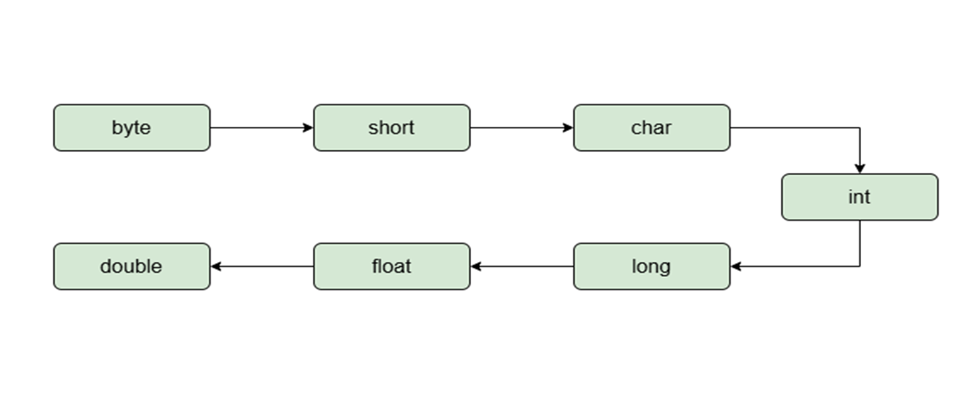
Implicit Casting
•Implicit type casting (type-safe casting) is the process in which the C# compiler automatically converts a smaller (compatible) data type into a larger data type (e.g., int to double) without any data loss. It is performed automatically by the compiler.

Slide 65
•Implicit Type Casting happens when:
•The two data types are compatible.
•When we assign a value of a smaller data type to a bigger data type.
•For example, in C#, the numeric data types like byte, short, int, long, double, float, decimal, etc. are compatible with each other but no automatic conversion is supported from numeric type to char type or Boolean type.
•Also, char and bool are not compatible with each other. So, before converting, the compiler will first check the type compatibility, and then it decides whether it is good to convert or throw some error.

Slide 66
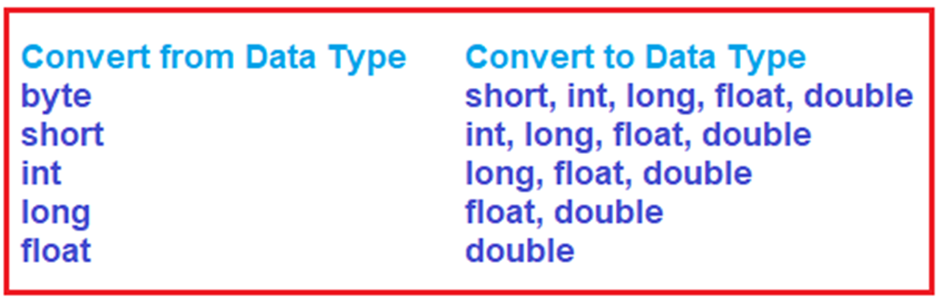

Slide 67
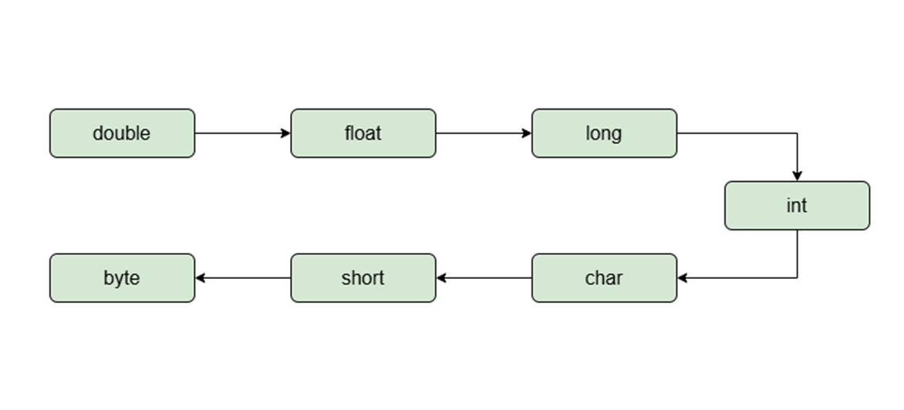
Explicit Type Casting
•Explicit type casting is the process of manually converting one data type into another using a cast operator (type). It is required when converting from a larger data type to a smaller one, or between incompatible types and may cause data loss or exceptions.
•

Slide 68
Type Conversion Methods
Method | Description
ToBoolean | It will converts a type to Boolean value
ToChar | It will converts a type to a character value
ToByte | It will converts a value to Byte Value
ToDecimal | It will converts a value to Decimal point value
ToDouble | It will converts a type to double data type
It will converts a type to Boolean value
ToChar
It will converts a type to a character value
ToByte
It will converts a value to Byte Value
ToDecimal
It will converts a value to Decimal point value
ToDouble
It will converts a type to double data type

Slide 69
Method | Description
ToString | It will converts a given type to string
ToUInt16 | It will converts a type to unsigned 16 bit integer
ToUInt32 | It will converts a type to unsigned 32 bit integer
ToUInt64 | It will converts a type to unsigned 64 bit integer
ToInt32 | It will converts a type to 32 bit integer
ToInt16 | It will converts a type to 16-bit integer
ToInt64 | It will converts a type to 64 bit integer

Slide 70
NAMESPACE

Slide 71
What is namespace
•A namespace is designed for providing a way to keep one set of names separate from another.
•The class names declared in one namespace does not conflict with the same class names declared in another.
Why Use Namespaces?
•Avoid Name Conflicts: Two classes with the same name can exist in different namespaces.
•Code Organization: Helps organize code into logical groups.
•Maintainability: Easier to manage large projects.

Slide 72
DECISION MAKING

Slide 73
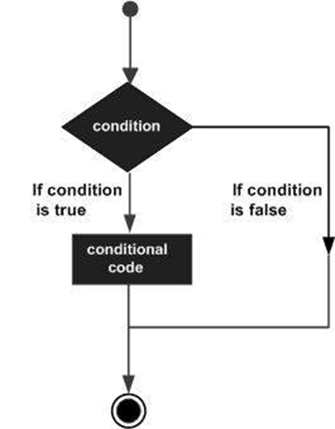
WHAT IS DECISION MAKING
•Decision making structures requires the programmer to specify one or more conditions to be evaluated or tested by the program, along with a statement or statements to be executed if the condition is determined to be true, and optionally, other statements to be executed if the condition is determined to be false.

Slide 74
Conditional statements of c#
There are few conditional statements of C# is mentioned below:
•if
•if-else
•if-else-if
•Nested if
•Switch
•Nested Switch

Slide 75
TYPES OF DECISION MAKING STATEMENTS
STATEMENT | DESCRIPTION
IF Statement | An if statement consists of a boolean expression followed by one or more statements.
IF ELSE Statement | An if statement can be followed by an optional else statement, which executes when the boolean expression is false
NESTED IF Statement | You can use one if or else if statement inside another if or else if statement(s).
SWITCH Statement | A switch statement allows a variable to be tested for equality against a list of values.

Slide 76
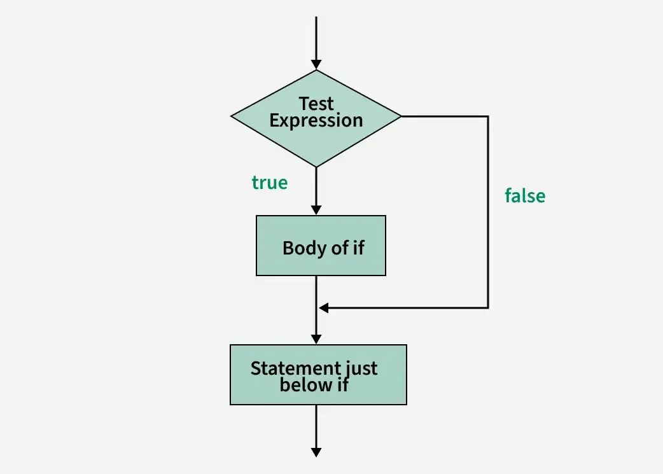
IF Statement
The if statement checks the given condition. If the condition evaluates to be true then the block of code/statements will execute otherwise not.

Slide 77
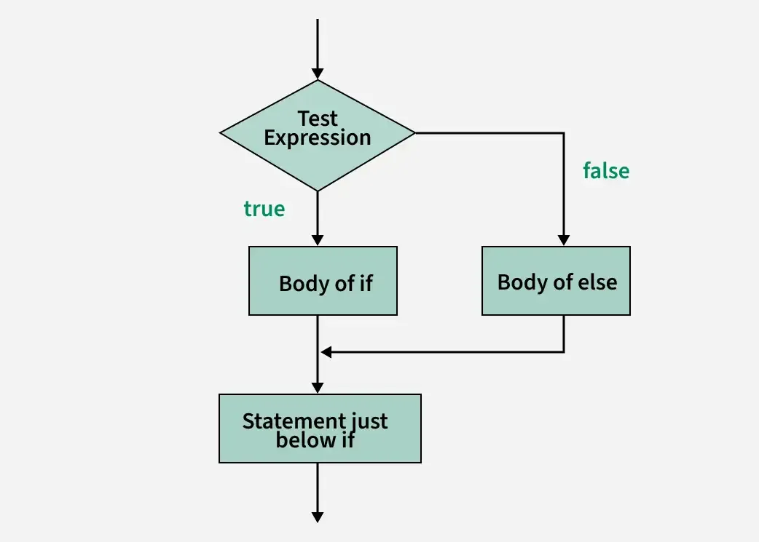
IF-ELSE Statement
The if statement evaluates the code if the condition is true but what if the condition is not true, here comes the else statement. It tells the code what to do when the if condition is false.

Slide 78
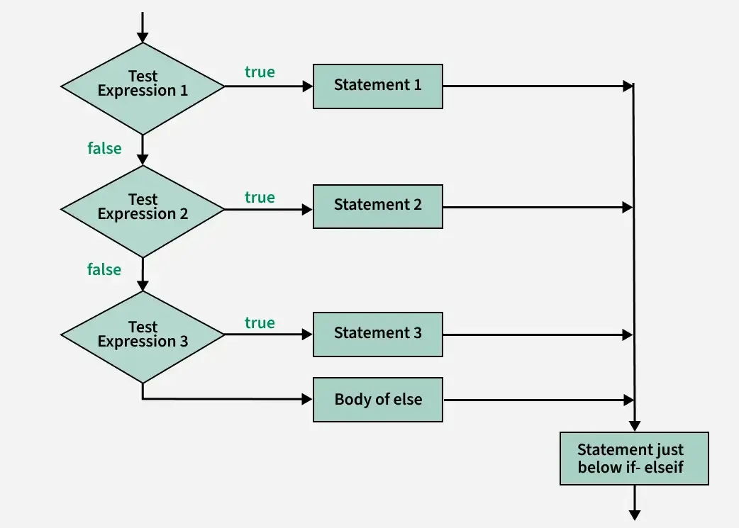
IF-ELSE-IF Statement
The if-else-if ladder is used when you need to test multiple conditions one after another.
The program evaluates each condition in order.
As soon as one condition is true, its block executes and the ladder ends.
If none of the conditions are true, the else block (if provided) executes.

Slide 79
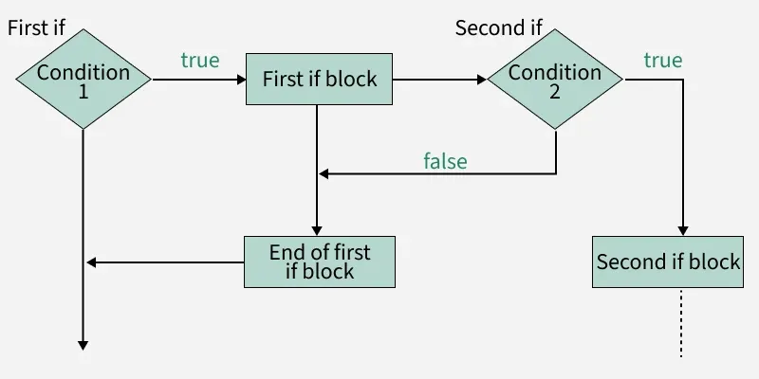
NESTED-IF Statement
If statement inside an if statement is known as nested if. if statement in this case is the target of another if or else statement.
When more than one condition needs to be true and one of the condition is the sub-condition of parent condition, nested if can be used.

Slide 80
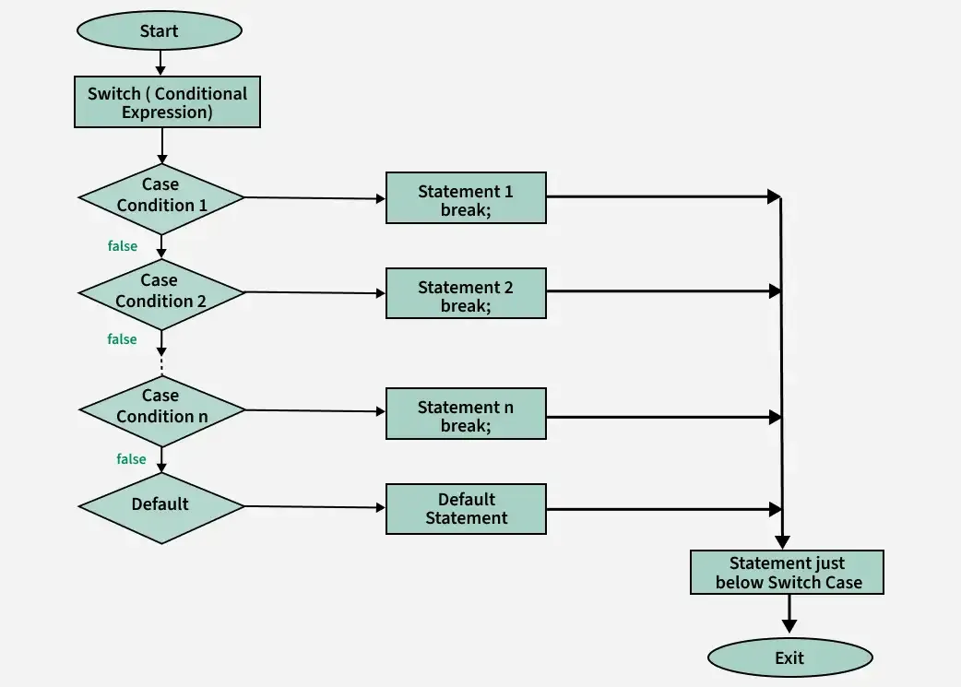
SWITCH Statement
Switch statement is an alternative to long if-else-if ladders. The expression is checked for different cases and the one match is execute.
Break Statement is used to move out of the switch. If the break is not used, the control will flow to all cases below it until break is found or switch comes to an end.

Slide 81
LOOPING STATEMENTS

Slide 82
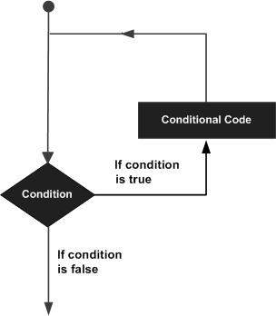
Looping Statements
Looping in a programming language is a way to execute a statement or a set of statements multiple times, depending on the result of the condition to be evaluated to execute statements. The result condition should be true to execute statements within loops.

Slide 83
TYPES OF LOOP
Sr.No. | Loop Type & Description
1 | while loop It repeats a statement or a group of statements while a given condition is true. It tests the condition before executing the loop body.
2 | for loop It executes a sequence of statements multiple times and abbreviates the code that manages the loop variable.
3 | do...while loop It is similar to a while statement, except that it tests the condition at the end of the loop body
4 | nested loops You can use one or more loop inside any another while, for or do..while loop.

Slide 84
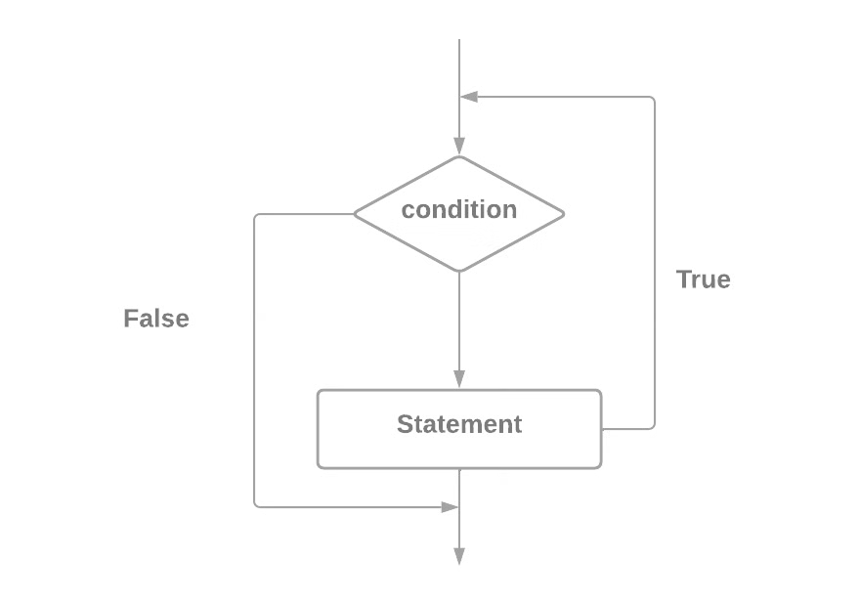
WHILE LOOP
The test condition is given at the beginning of the loop and all statements are executed till the given Boolean condition is satisfied. When the condition becomes false, the control will be out of the while loop.

Slide 85
  In the while loop, the Boolean expression is first calculated, and if it is true, the sequence of operations in the loop's body is executed.
  The input condition is then checked again, and if it is true, the loop's body is executed once more.
  All of this is repeated until the conditional expression returns false at some point.
  At this point, the loop is terminated, and the program proceeds to the next line, immediately following the loop's body.
  If the cycle condition returns false at the start, the body of the while loop may not be executed even once. If the cycle's condition is never broken, the loop will continue indefinitely.

Slide 86
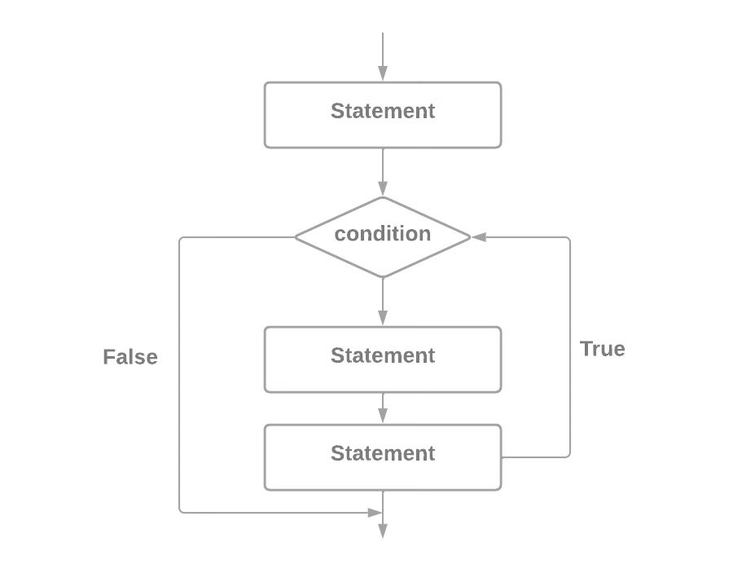
FOR LOOP
The C# for loop is a repetition control structure that executes a block of code a specific number of times instead of writing the same code multiple times.
It is especially useful when the number of iterations is known in advance.
When you know exactly how many times you want to loop through a block of code, use the for loop instead of a while loop:

Slide 87
Control Flow of For Loop
The init step is executed first, and only once. This step allows you to declare and initialize any loop control variables. You are not required to put a statement here, as long as a semicolon appears.
Next, the condition is evaluated. If it is true, the body of the loop is executed. If it is false, the body of the loop does not execute and flow of control jumps to the next statement just after the for loop.
After the body of the for loop executes, the flow of control jumps back up to the increment statement. This statement allows you to update any loop control variables. This statement can be left blank, as long as a semicolon appears after the condition.
The condition is now evaluated again. If it is true, the loop executes and the process repeats itself (body of loop, then increment step, and then again testing for a condition). After the condition becomes false, the for loop terminates

Slide 88
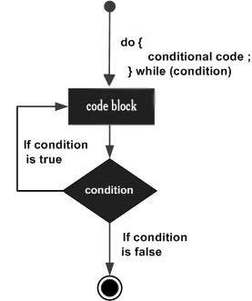
DO-WHILE LOOP
A do-while loop in C# is similar to a while loop, but it guarantees at least one execution of the loop body, even if the condition is false. This makes it useful for scenarios where the loop body must run at least once before evaluating the condition.

Slide 89
The loop body is executed first, and its condition is evaluated.
If it is true, the loop's body is repeated; otherwise, it is terminated.
This logic is repeated until the loop's condition is broken. The loop's body is executed at least once.
If the loop's condition is always true, the loop will never end.

Slide 90
NESTED LOOPvs
A nested loop in c# states that a loop inside another loop where the inner loop executes completely for each iteration of the outer loop. The following section shows a few examples to illustrate the nested loops.
  Following the initialization of the first for loop, the execution of its body, which contains the second (nested) loop, will begin.
  Its variable will be initialized, its condition will be checked, and it will execute the code within its body, followed by the variable being updated and execution continuing until the condition returns false.
  Following that, the second iteration of the first for loop will continue, its variable will be updated, and the entire second loop will be repeated.
  The inner loop will be executed as many times as the outer loop's body.

Slide 91
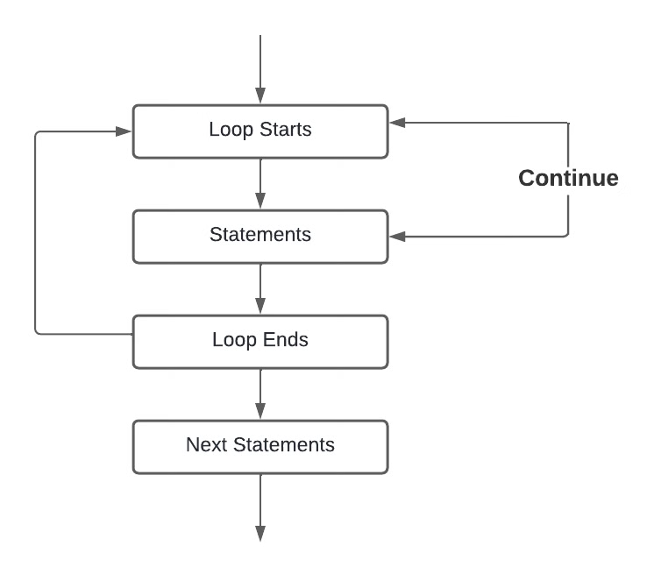
CONTINUE LOOP
Continue is one of many conditional statements in the C# programming language that can be used inside a conditional loop block to function as a clause to continue the loop execution after the iterative condition is executed to move on to the execution of the next iteration in the conditional loop. It is commonly used with iterative conditional loops such as a for-while loop, a do-while loop, and a for-each loop

Slide 92
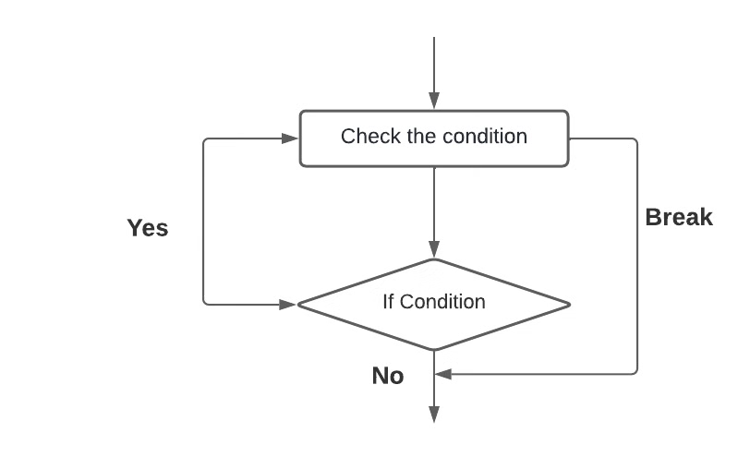
BREAK LOOP
The break statement is used to end the loop or statement that it is present in. If they are present, it will pass the control to the statements that follow the break statement. If the break statement is present in the nested loop, it only terminates the loops that contain the break statement.

Slide 93
OBJECT-ORIENTED PROGRAMMING

Slide 94
What is OOPs
OOP (Object-Oriented Programming) is a programming approach that uses objects and classes to organize code by combining data and methods into a single unit.
Object-oriented programming has several advantages over procedural programming:
OOP is faster and easier to execute
OOP provides a clear structure for the programs
OOP helps to keep the C# code DRY "Don't Repeat Yourself", and makes the code easier to maintain, modify and debug
OOP makes it possible to create full reusable applications with less code and shorter development time

Slide 95
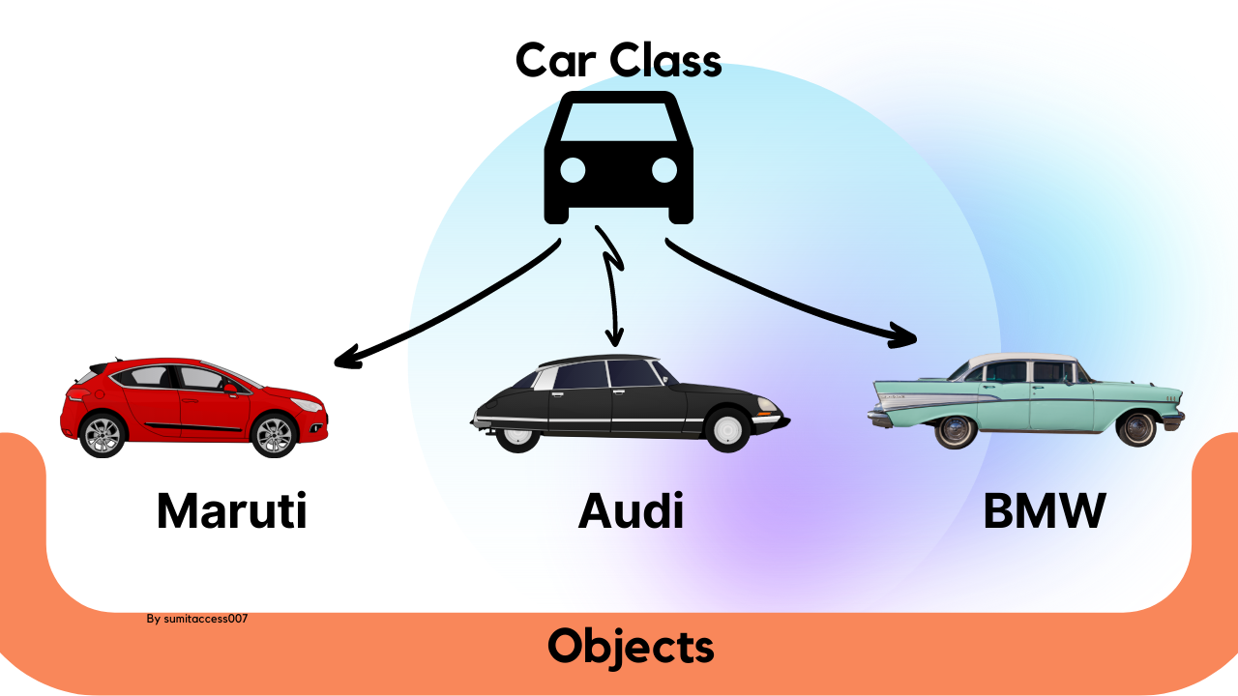
What are Class and Objects
Class: A class is a blueprint or template for creating objects. It defines the structure (attributes or properties) and behavior (methods or functions) that objects of that class will possess.
Object: An object is an instance of a class. When you create an object, you are creating a concrete entity based on the class's blueprint.

Slide 96
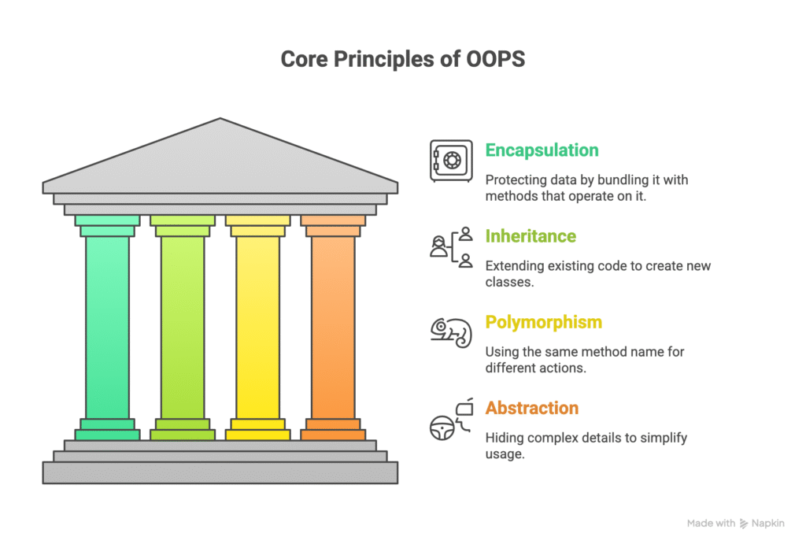
PILLARS OF OOPs
Object Oriented Programming is based on four fundamental principles that make programs organized, reusable, and maintainable:
    Encapsulation
    Abstraction
    Inheritance
    Polymorphism

Slide 97
ENCAPSULATION
Encapsulation is the bundling of data (attributes) and methods (functions) that operate on the data within a single unit, the class. It also involves restricting direct access to some of an object's components, meaning that the internal workings are hidden from the outside world. This is achieved using access modifiers (e.g., public, private, protected).
Key Points:
Data members (variables) are private.
Methods (functions) are public to access or modify data.
Helps in maintaining data integrity and security.

Slide 98
Key aspects of encapsulation in C#:
Bundling Data and Methods: Encapsulation combines related data and the methods that manipulate that data within a single class. For example, a BankAccount class might encapsulate a balance field and methods like Deposit() and Withdraw().
Information Hiding (Data Hiding): A core aspect of encapsulation is hiding the internal implementation details of a class from outside access. This is achieved through access modifiers like private, protected, and internal. By declaring fields as private, their direct access from outside the class is prevented, ensuring that data can only be manipulated through controlled methods or properties.
Controlled Access: Instead of direct access to private fields, public methods or properties are provided to interact with the encapsulated data. These methods or properties can include validation logic or other business rules to ensure data integrity.

Slide 99
Advantages of Encapsulation:
Protects data from being modified incorrectly
Makes code more secure and robust
Provides controlled access to variables
Improves maintainability

Slide 100
ABSTRACTION
Data Abstraction is the property by which only the essential details are shown to the user and non-essential details or implementations are hidden from the user.
In other words, Data Abstraction may also be defined as the process of identifying only the required characteristics of an object ignoring the irrelevant details.
The properties and behaviours of an object differentiate it from other objects of similar type and also help in classifying/grouping the objects.

Slide 101
Key aspects of abstraction in C#
Hiding Complexity: Abstraction aims to present a simplified view of an object or system, allowing users to interact with it without needing to understand the intricate inner workings. This reduces cognitive load and improves usability.
Focus on "What" not "How": Abstraction emphasizes the "what" an object does rather than the "how" it achieves it. This promotes a clear separation of concerns, where the interface defines the expected behavior, and the implementation provides the specifics.

Slide 102
Advantages of Abstraction:
Hides complex implementation
Shows only necessary features to the user
Makes code easy to use and maintain
Supports modular design

Slide 103
INHERITANCE
Inheritance in C# is an object-oriented programming (OOP) feature that allows one class to derive properties and behaviors from another class.
It promotes code reusability, extensibility and establishes a natural hierarchical relationship between classes.

Slide 104
Key Concepts of Inheritance in C#
Base Class (Parent Class): The class whose members (properties, methods, fields) are inherited.
Derived Class (Child Class): The class that inherits members from the base class. It can also add its own unique members and override inherited methods.
Code Reusability: Inheritance allows you to define common functionalities in a base class and reuse them in multiple derived classes, reducing code duplication.
Extensibility: Derived classes can extend the functionality of the base class by adding new members or modifying existing ones.
Achieving Inheritance: In C#, inheritance is achieved using the colon (:) symbol in the class declaration.

Slide 105
Advantages of Inheritance:
Code Reusability: Avoids rewriting common code
Logical Hierarchy: Models real-world relationships
Extensibility: Child classes can add new features
Maintainability: Changes in parent class automatically reflect in child class

Slide 106
Polymorphism is a Greek word meaning "one name many forms." "Poly" means many, and "morph" means forms.
In other words, one object has many forms or has one name with multiple functionalities.
Polymorphism allows a class to have multiple implementations with the same name. It is one of the core principles of Object Oriented Programming after encapsulation and inheritance.
There are two main types of polymorphism in C#: Compile-time Polymorphism (Static Polymorphism), Run-time Polymorphism (Dynamic Polymorphism).

Slide 107
Compile-time Polymorphism (Static Polymorphism).
This type of polymorphism is resolved during the compilation phase. It is primarily achieved through:
Method Overloading: Defining multiple methods within the same class that have the same name but different parameter lists (different number of parameters, different types of parameters, or different order of parameters). The compiler determines which method to call based on the arguments provided during the method call.
Operator Overloading: Defining how operators (like +, -, *, /) behave when applied to user-defined types.

Slide 108
Run-time Polymorphism (Dynamic Polymorphism)
This type of polymorphism is resolved during the execution of the program. It is primarily achieved through:
Method Overriding: A derived class provides its own specific implementation of a method that is already defined in its base class. To enable overriding, the method in the base class must be declared with the virtual keyword, and the overriding method in the derived class must use the override keyword. When a base class reference points to a derived class object, calling the virtual method will execute the derived class's overridden implementation.

Slide 109
Advantages of Polymorphism:
Code Reusability: Allows the use of a common interface for different types of objects.
Flexibility and Extensibility: Facilitates adding new derived classes without modifying existing code that uses the base class interface.
Maintainability: Simplifies code by providing a consistent way to interact with different object types.

Slide 110
ACCESS MODIFIERS

Slide 111
What is Access Modifiers
Access modifiers control where a type or member (field, method, property, nested type, etc.) can be accessed from: same class, derived classes, same assembly, or anywhere.
List of Access Modifiers.
    Public
    Private
    Protected
    Internal
    Private Protected
    Public Internal

Slide 112
PUBLIC MODIFIER
Members declared public can be accessed from any part of the program, including from different assemblies (projects), provided the assembly containing the public member is referenced.
Access is unrestricted.

Slide 113
PRIVATE MODIFIER
  Access is restricted to the containing type (class or struct).
  Members declared private can only be accessed from within the same class or struct where they are defined.
  This is the default access modifier if no other modifier is specified for members within a class.

Slide 114
PROTECTED MODIFIER
  Access is limited to the containing class and types derived from the containing class (subclasses).
  Members declared protected are accessible within the class itself and any class that inherits from it, even if the derived class is in a different assembly.

Slide 115
INTERNAL MODIFIER
  Access is limited to the current assembly (the project or DLL where it's defined).
  Members declared internal can be accessed by any code within the same assembly but not from outside that assembly.

Slide 116
PROTECTED INTERNAL
  This is a combination of protected and internal.
  Members declared protected internal are accessible within the current assembly or by types derived from the containing class, even if those derived types are in a different assembly.

Slide 117
PRIVATE PROTECTED
  This is a combination of private and protected.
  Members declared private protected are accessible only within the containing class and by types derived from the containing class within the same assembly.

Slide 118
Modifiers | Entire program | Containing Class | Current assembly | Derived Types | Derived Types within Current Assembly
public | Yes | Yes | Yes | Yes | Yes
private | No | Yes | No | No | No
protected | No | Yes | No | Yes | Yes
internal | No | Yes | Yes | No | Yes
protected internal | No | Yes | Yes | Yes | Yes
private protected | No | Yes | No | No | Yes

Slide 119
VIRTUAL, ABSTRACT,SEALED, NEW KEYWORD

Slide 120
VIRTUAL KEYWORD
The virtual keyword allows a class to be overridden. For overriding a parent class method in the child class, declare the parent class method as virtual.
  Purpose: To indicate that a method or property can be optionally overridden by a derived class.
  Usage: Applied to a method or property. The base class can provide a default implementation, but derived classes have the choice to override it using the override keyword.

Slide 121
ABSTRACT KEYWORD
Abstract classes contain abstract methods, which are implemented by the derived class.
  Purpose: To define a contract for a base class that derived classes must adhere to.
  Usage: Applied to a class or a method. An abstract class cannot be instantiated directly. abstract methods do not have an implementation in the base class and must be implemented in the inheriting class.

Slide 122
SEALED KEYWORD
When a class is declared sealed, it cannot be inherited, abstract classes cannot be declared sealed.
To prevent being overridden, use the sealed in C#. When you use sealed modifiers in C# on a method, then the method loses its capabilities of overriding. The sealed method should be part of a derived class and the method must be an overridden method.
  Purpose: To prevent inheritance of a class or to prevent a specific method or property from being overridden.
  Usage: Applied to a class or a member. A sealed class cannot have any derived classes. A sealed member cannot be overridden.

Slide 123
NEW KEYWORD
Use the new keyword to hide the base class method from the derived class. This is done by declaring the derived class function with new.
  Purpose: To hide an inherited member that has the same name as a member in the base class. This is also known as method hiding or shadowing.
  Usage: Applied to a member in a derived class. It creates a new, independent member in the derived class rather than overriding an existing one in the base class. It is not used for overriding, but for creating a new member with the same name.

Slide 124
INTERFACE
In C#, an interface defines a contract that a class or struct must adhere to.
An interface looks like a class but has no implementation. The only thing it contains is declarations of events, indexers, methods, and/or properties.
The reason interfaces only provide declarations is that they are inherited by structs and classes, which must provide an implementation for each interface member declared.

Slide 125
KEY CHARACTERISTIC OF INTERFACE
  Contractual Obligation: An interface serves as a blueprint, declaring what functionalities a class or struct must possess if it implements that interface. Any class or struct implementing an interface is obligated to provide an implementation for all its declared members.
  Abstraction: Interfaces promote abstraction by separating the "what" (the contract) from the "how" (the implementation). This allows for greater flexibility and reusability of code, as different classes can implement the same interface in their own unique ways.
  Multiple Inheritance (via Interfaces): While C# does not support multiple inheritance of classes, it allows a class to implement multiple interfaces. This provides a mechanism to achieve similar benefits to multiple inheritance by combining different sets of functionalities.

Slide 126
  No Instance Fields or Constructors: Interfaces cannot contain instance fields or constructors because they cannot be directly instantiated. They only define the contract for behavior, not the state of an object.
  Default Public and Abstract: All members declared within an interface are implicitly public and abstract. Explicit access modifiers are generally not used for interface members.
  Declaration: Interfaces are declared using the interface keyword, conventionally prefixed with an "I" (e.g., IAnimal, IDisposable).

Slide 127
DIFFERENCE OF ABSTRACT AND INTERFACE
Feature | Abstract Class | Interface
Instantiation | Cannot be instantiated directly. Serves as a base class for derived classes. | Cannot be instantiated directly.
Implementation | Can contain a mix of concrete methods (with implementation) and abstract methods (without implementation). | Starting with C# 8.0, interfaces can define default implementations for methods. Previously, they could only contain method signatures.
Inheritance | A class can inherit from only one abstract class. This is C#'s way of enforcing single-class inheritance. | A class can implement multiple interfaces, allowing it to adopt behaviors from multiple sources.
Members | Can include fields, properties, constructors, and events. Supports access modifiers like public, protected, and private. | Can contain properties, methods, events, and indexers. Instance fields are not allowed. Interface members are public by default.

Slide 128
Feature | Abstract Class | Interface
Inheritance hierarchy | Ideal for defining the core identity of a component within a closely related class hierarchy (e.g., Dog is an Animal). | Perfect for defining peripheral capabilities that can be used by unrelated classes (e.g., a Dog can implement an IWalk or ISwim interface).
Versioning | Adding a new non-abstract method to an abstract class does not break existing derived classes, since they can inherit the default behavior. | Adding a new member to an interface (before C# 8.0) would break all implementing classes. Default interface implementations mitigate this problem.

Slide 129
PARTIAL CLASS AND METHOD

Slide 130
PARTIAL CLASS
Partial Class is the new feature that has been added in C# 2.0 which allows us to define a class on multiple files i.e. we can physically split the content of the class into different files but even physically they are divided but logically it is one single unit only.
A class in which code can be written in two or more files is known as a partial class. To make any class partial we need to use the keyword partial.
Partial classes are commonly used in scenarios such as Windows Forms, ASP.NET applications and code generators where some parts of the class are system-generated and others are written by the programmer

Slide 131
KEY POINTS OF PARTIAL CLASS
  Declared using the partial keyword.
  A class can be split across multiple files.
  All parts must use the same name and namespace.
  At compile time, the compiler merges all parts into a single class.
  Useful for separating auto-generated and user-defined code.
  Supports defining fields, methods, properties, events and nested classes.

Slide 132
RULES OF PARTIAL KEYWORD
Partial Keyword: All parts of a partial class, struct, or interface definition must be explicitly marked with the partial keyword.
Same Assembly and Module: All parts of a partial type must reside within the same assembly and the same module. They cannot be spread across different assemblies or DLLs.
Same Namespace: All parts of a partial type must be defined within the same namespace.
Same Accessibility: All parts of a partial type must have the same accessibility level (e.g., public, private, internal).
Unified Type Characteristics:
  If any part of a partial class is declared abstract, the entire class becomes abstract.
  If any part is declared sealed, the entire class becomes sealed.
  If any part declares a base type or implements an interface, the entire type inherits that base type or implements that interface. The final class will inherit all base types and implement all interfaces declared across its parts.

Slide 133
Constructors: Constructors declared in different parts of a partial class must have different signatures. You cannot have multiple constructors with the same signature, even if they are in separate partial files.
Members: Members (fields, properties, methods, events) declared in any part of a partial type are available to all other parts of that type.
Partial Methods: Partial classes can contain partial methods, which consist of a signature declaration in one part and an optional implementation in another part. Both the declaration and implementation must use the partial keyword. If no implementation is provided, the method and its calls are removed during compilation.

Slide 134
PARTIAL METHOD
A partial method is a special kind of method that can be declared inside a partial class or partial struct. It allows you to define a method signature in one part of the class and optionally implement it in another part.
If no implementation is provided, the compiler removes the declaration at compile time, meaning no extra overhead is added. This makes partial methods useful in scenarios where a method might or might not be required, especially in code generation.

Slide 135
KEY POINTS
  Declared with the partial keyword.
  Must exist inside a partial class or partial struct.
  Can have a declaration (signature) and an optional implementation.
  If no implementation is provided, the compiler removes the declaration.
  Must return void (cannot have a return type other than void).
  Cannot have access modifiers (public, private, etc.).
  Can be static (in C# 9.0 and later) but cannot be virtual, abstract, override, extern or async.

Slide 136
RULES OF PARTIAL METHOD
Partial Type Requirement: Partial methods can only be declared within a partial class or partial struct.
partial Keyword: The method declaration must begin with the partial keyword.
Signature Matching: The signature (name, parameters, and generic type parameters) of the partial method must be identical in both the declaration and any optional implementation.
Return Type: Partial methods must have a void return type. They cannot return any other value.
Access Modifiers: Partial methods are implicitly private by default and cannot have explicit access modifiers (e.g., public, protected, internal).
No Implementation Required: An implementation for a partial method is optional. If no implementation is provided in any part of the partial type, the compiler will remove the declaration and any calls to the method during compilation.

Slide 137
STATIC MEMBER

Slide 138
STATIC MEMBER
The static keyword in C# is used to declare members that belong to the type itself rather than to a specific object.
It means the member can be accessed without creating an instance of the class. The static keyword can be applied to variables, methods, constructors, classes and other members.

Slide 139
KEY CHARACTERISTICS OF STATIC MEMBERS
Shared across objects: All instances of a class share the same copy of a static member. For example, a static field will have only one value for all objects of that class.
Accessed without objects: Static members are accessed directly using the class name, without needing to create an instance of the class.
Memory allocation: Memory for static members is allocated only once when the class is loaded into memory, not when objects are created.
Restrictions: Static methods can only access other static members (fields, properties, or methods) within the same class directly. They cannot access non-static (instance) members without an explicit instance of the class.

Slide 140
TYPES OF STATIC MEMBERS
STATIC FIELD:
A static field is created only once for the class and all objects share the same copy. It is often used for counters or values that must remain consistent across instances.
STATIC METHODS:
They perform operations on static fields or provide utility functions that don't require an object's state. They cannot access instance members directly.
Static Constructors:
Static constructors are used to initialize static fields. They execute only once, before the class is used for the first time.

Slide 141
STATIC CLASS:
A static class is a class declared using the static keyword. It can contain only static members such as fields, methods, properties and events. A static class cannot be instantiated or inherited and all its members are accessed through the class name.
Static classes are commonly used to group utility or helper methods that do not depend on object state.

Slide 142
Key Points
A static class is declared using the static keyword.
All members inside a static class must be static.
It cannot be instantiated using the new keyword.
It is implicitly sealed, so it cannot be inherited.
A static class can only have the public or internal access modifiers (it cannot be private, protected, etc.).

Slide 143
ARRAY & STRINGS

Slide 144
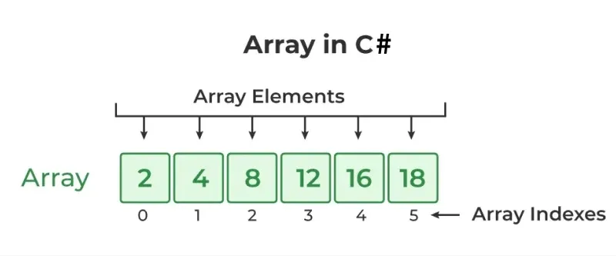
ARRAY
Arrays in C# are collections of elements stored in contiguous memory locations, ensuring quick access and efficient processing.
Each element shares the same data type, providing type safety and consistent behavior.
The size of an array is fixed when it is declared and cannot be changed dynamically, making arrays ideal for managing collections with a known, unchanging number of items.
Elements are accessed using zero-based indices, starting at 0, enabling straightforward and predictable data retrieval and manipulation.

Slide 145
TYPES OF ARRAY
Single-Dimensional Arrays: The most common type, storing elements in a single row.
  Example : Storing Name, List of Numbers,
Multidimensional Arrays (Rectangular Arrays): Arrays with more than one dimension,
  Example: Matrices, Grid, Table
Jagged Arrays: Arrays of arrays, where each inner array can have a different size.
  Example: Storing rows with differing lengths

Slide 146
MEMORY STRUCTURE AND PERFORMANCE
Fixed Size Constraint:
Arrays have a fixed size set at initialization, restricting dynamic resizing. To resize, you must create a new array and copy existing elements.
Performance Trade-Offs:
The efficient memory layout boosts performance and cache utilization but limits flexibility due to lack of dynamic growth.
Contiguous Memory Allocation:
Arrays store elements sequentially in adjacent memory locations, enabling fast, constant-time indexed access and improved cache locality.

Slide 147
KEY CHARACTERISTICS OF ARRAY
Fixed Size: Once an array is declared and initialized, its size cannot be changed. This means the number of elements it can hold is determined at creation and remains constant throughout its lifetime.
Homogeneous Elements: All elements within a single array must be of the same data type. For example, an int[] can only store integers, and a string[] can only store strings.
Zero-Based Indexing: Array elements are accessed using an index, which starts from 0 for the first element and goes up to length - 1 for the last element.
Reference Types: Arrays in C# are reference types, meaning they are objects derived from the System.Array base class. When you declare an array variable, it holds a reference to the array object in memory, not the array itself.
Memory Efficiency: Arrays store elements in contiguous memory locations, which allows for efficient access to elements using their index (O(1) time complexity for random access).

Slide 148
Built-in Length Property: Arrays have a Length property that returns the total number of elements in the array. For multidimensional arrays, GetLength(dimension) can be used to get the length of a specific dimension.
Iteration Support: Arrays implement IEnumerable (and IEnumerable<T> for single-dimensional arrays), allowing them to be easily iterated using a foreach loop.

Slide 149
STRING
In C#, a string is a sequence of characters used to represent text. Strings are immutable, meaning that once created, their values cannot be changed.
A string is a sequence of Unicode characters (U+0000 to U+FFFF) used to represent text. It is an object of the System.String class.

Slide 150
STRING PROPERTIES
Length Property
The Length property of a string returns the number of characters in the string, useful for validating input or managing string data.
Indexing:
Strings support indexing, allowing access to individual characters using zero-based indexing, e.g., char firstChar = greeting[0]; gives 'H'.
String Interpolation:
A feature that allows embedding expressions inside string literals, improving legibility. For example, $"Value: {value}" dynamically includes variable content.

Slide 151
KEY CHARACTERISTICS OF STRING
  Immutability: Once a string object is created, its value cannot be changed. Any operation that appears to modify a string (like concatenation or replacement) actually creates a new string object in memory.
  Sequential Collection of Characters: Internally, a string stores text as a read-only collection of Char objects.
  Unicode Support: Strings handle Unicode characters, allowing for a wide range of international text.
  Rich Functionality: The String class provides numerous methods and properties for manipulating, comparing, searching, and formatting strings.

Slide 152
COLLECTION

Slide 153
WHAT IS COLLECTION
Collections in C# are classes designed to store, retrieve, and manipulate groups of objects. They offer more flexibility than arrays, particularly concerning dynamic sizing.
C# provides both non-generic and generic collections, with generic collections being generally preferred due to their type safety and performance benefits.
Types of Collection:
Generic Collection
Non-Generic Collection
Concurrent Collection

Slide 154
KEY CHARACTERISTICS OF COLLECTION
Characteristic | Explanation
Dynamic Size | Collections can grow or shrink automatically as elements are added or removed — unlike arrays which have a fixed size.
Type Safety (in Generic Collections) | Generic collections (like List<T>, Dictionary<TKey, TValue>) are type-safe, meaning they only store a specific data type, preventing runtime errors.
Data Organization | Collections provide structured ways to store data — like lists (ordered), sets (unique elements), or dictionaries (key-value pairs).
Rich Built-in Methods | Collections have many methods such as Add(), Remove(), Contains(), Sort(), Find(), and Clear() to make data management easier.

Slide 155
Characteristic | Explanation
Iteration Support | Most collections implement the IEnumerable or IEnumerable<T> interface, so you can loop through them using foreach.
Flexibility | Collections can store primitive types (like int, string) and custom objects (like Student, Employee).
Performance | Different collection types are optimized for different operations — for example, List<T> is fast for sequential access, while Dictionary<TKey, TValue> is fast for lookups.
Memory Management | Collections handle memory automatically — when elements are added or removed, the collection manages the internal storage.
Sorting and Searching | Many collections provide built-in sorting and searching capabilities (e.g., SortedList, List<T>.Sort()).
Thread Safety (Concurrent Collections) | Collections under System.Collections.Concurrent are thread-safe, making them safe to use in multi-threaded environments.

Slide 156
NON-GENRIC COLLECTIONS
Non-Generic Collections are a set of classes in the System.Collections namespace that were introduced before generics were added to .NET (in .NET Framework 1.0).
These collections use boxing and unboxing to convert value types into objects when storing them, and back to their original types when retrieving them. This process can lead to performance overhead.
Non-generic collections provide the same core functionalities as generic collections — such as adding, removing, and retrieving items — but they lack type safety. Because they store data as object, there’s a risk of runtime errors if an incorrect data type is used during casting.

Slide 157
1. Type Safety
Non-Generic Collections are not type-safe because they store all elements as object.
Any type of data (int, string, etc.) can be added to the same collection.
This flexibility can lead to runtime errors if data types are mismatched.
2. Boxing and Unboxing
When storing value types (e.g., int, double, struct), the data is boxed — converted to an object.
When retrieving, it must be unboxed — converted back to its original type.
This boxing/unboxing process causes performance overhead.

Slide 158
3. Explicit Casting
When you retrieve elements from a non-generic collection, they are returned as objects, not as their original data types.
So, you must explicitly cast each element back to its actual type (for example, converting an object back to an int or string).
This process is called explicit casting, and it can be time-consuming and error-prone, especially if the wrong data type is used during casting — it can cause a runtime error.

Slide 159
ArrayList
Stores any type of data (int, string, double, etc.)
Size increases automatically when new elements are added.
Uses index numbers to access items.
Internally stores all elements as objects (needs boxing/unboxing).
Hashtable
Stores key–value pairs (like a dictionary).
Keys must be unique, but values can be duplicate.
Data is retrieved using the key.
Order of items is not guaranteed.

Slide 160
Stack
Stack stores the values in LIFO style (Last In First Out).
It provides a Push() method to add a value and Pop() & Peek() methods to retrieve values.
Queue
Queue stores the values in FIFO style (First In First Out).
It keeps the order in which the values were added. It provides an Enqueue() method to add values and a Dequeue() method to retrieve values from the collection.

Slide 161
BitArray
Stores a sequence of bits (true/false).
Used for binary operations or compact data storage.
Each bit represents a Boolean value.
SortedList
SortedList stores key and value pairs.
It automatically arranges elements in ascending order of key by default.

Slide 162
GENERIC COLLECTION
Generic collections in C# are classes located in the System.Collections.Generic namespace that provide type-safe and efficient ways to store and manage collections of objects.
They utilize generics to specify the type of elements they will contain at the time of creation, ensuring compile-time type safety and eliminating the need for casting and the performance overhead of boxing/unboxing for value types.

Slide 163
KEY FEATURES OF GENERIC COLLECTION
1.Dynamic Sizing
Collections can automatically grow or shrink as elements are added or removed.
No need to predefine a fixed size (unlike arrays).
2.Data Manipulation Operations
Collections include built-in methods for:
Adding elements (Add(), Insert())
Removing elements (Remove(), RemoveAt())
Searching (Contains(), IndexOf())
Sorting (Sort())
Retrieving data (Find(), indexing)

Slide 164
Type Safety (Generic Collections)
Generic collections like List<T> and Dictionary<TKey, TValue> enforce type safety.
Only a specific data type can be stored in them.
Prevents runtime casting errors and improves code reliability.
Interface-Based Design
Collections implement common interfaces such as:
  IEnumerable – allows iteration using foreach
  ICollection – provides size and synchronization info
  IList – enables index-based access
  Promotes consistency, flexibility, and polymorphism across all collections.

Slide 165
GENERIC COLLECTION DATA TYPES
List<T>
A List<T> is a strongly typed dynamic array that can store elements of a specific type (like int, string, or a class).
It grows automatically as new elements are added — no need to specify size like an array.
Provides index-based access to elements.
Allows duplicate values and maintains insertion order.
Use Case:
Best for lists of related data (e.g., student names, product IDs).
Key Features:
Indexed access
Supports sorting and searching.
Maintains insertion order.

Slide 166
Dictionary<TKey, TValue>
Description:
Stores key–value pairs.
Each key is unique, and each key maps to a single value.
Provides fast lookups using keys.
Use Case:
Ideal for storing data like student roll numbers and names.
Key Features:
Unique keys
Duplicate values allowed
Quick access using keys

Slide 167
SortedList<TKey, TValue>
Description:
Similar to Dictionary but automatically sorts elements by their keys.
Combines the features of a list and a dictionary.
Use Case:
Ideal when data needs to be retrieved in sorted order.
Key Features:
Key–value pairs
Sorted automatically by key
Fast retrieval

Slide 168
Queue<T>
Description:
Follows FIFO (First In, First Out) principle.
The first element added is the first to be removed.
Maintains order of insertion.
Use Case:
Useful for task scheduling or message queues.
Key Features:
FIFO structure
Maintains insertion order
deal for sequential processing

Slide 169
Stack<T>
Description:
Follows LIFO (Last In, First Out) principle.
The last element added is the first to be removed.
Used in undo operations or backtracking.
Use Case:
Web browser history, undo feature in editors.
Key Features:
LIFO structure
Access only to the top element
Reverses order of processing

Slide 170
HashSet<T>
Description:
Stores a collection of unique elements only.
Automatically removes duplicates.
Does not maintain any specific order.
Use Case:
Useful for sets of unique items like IDs or categories.
Key Features:
No duplicates
Unordered collection
Fast lookup operations

Slide 171
WHAT IS GENERIC
Generics in C# allow you to create classes, methods, interfaces, and collections that can work with any data type while maintaining type safety and performance.
Provide type safety and code reusability.
Avoids runtime errors and type conversions

Slide 172
GENERIC CLASS
A generic class defines a class with type parameters.
It allows the same class to handle data of different types without rewriting code.
Declared using angle brackets <T>.

Slide 173
KEY FEATURES OF GENERIC CLASS
Type Flexibility: Works with any data type.
Type Safety: Type errors caught at compile-time.
Reusability: Write once, use for multiple types.
Performance: No boxing/unboxing required.

Slide 174
GENERIC METHOD
A generic method defines type parameters for a single method.
Works with different data types without overloading.
Declared using <T> after the method name.
Example Concept: void Display<T>(T value) → Can accept any data type.

Slide 175
KEY FEATURES OF GENERIC METHOD
Type Independent: Can process various data types.
No Overloading Needed: One method works for all types.
Compile-time Checking: Detects type mismatches early.
Reusability: Reduces redundant method code.

Slide 176
DELEGATE, ANONYMOUS METHOD, LAMBDA EXPRESSION

Slide 177
DELEGATE
Delegate are useful for passing method as input parameter.
Method reference by delegate must have the same return type and parameter.
A delegate is type safe function pointer.
Delegates are used in event handling, callback methods, etc.
Types of Delegate
Single Cast Delegate.
Multi-Cast Delegate
Anonymous Delegate

Slide 178
SINGLE CAST DELEGATE
A single-cast delegate is a delegate instance that points to a single method at a time. When this delegate is invoked, only that specific method is executed.
Characteristics:
  It holds a reference to just one function.
  This is the default type for any delegate declaration unless methods are added or removed explicitly .
Use Case: Ideal for scenarios where a simple callback or a single event handler is needed, such as a function that needs to be executed after a specific operation is completed [2].

Slide 179
MULTI CAST DELEGATE
A multicast delegate is a delegate instance that points to multiple methods simultaneously . When the delegate is invoked, all the methods it references are executed sequentially in the order they were added .
Characteristics:
  It uses the + operator to add more methods to its invocation list and the - operator to remove them.
  All methods must have the same return type and parameters as the delegate definition.
  If any of the methods have a non-void return type, only the return value of the last method in the invocation list is received when the delegate is called; the return values of the previous methods are lost
Use Case: Commonly used for implementing event handling, where multiple subscribers (methods) need to be notified when an event occurs

Slide 180
ANONYMOUS DELEGATE
An anonymous delegate is a way to define a method inline where the delegate is expected, without needing to write a separate, named method . It avoids the overhead of creating a dedicated method for a small piece of functionality.
Characteristics:
  It is a code block passed directly as a parameter to a method or assigned to a delegate instance.
  It can access local variables and parameters of the enclosing method (a feature known as "capturing" variables).
  In modern C# (from C# 3.0 onwards), anonymous delegates have largely been superseded by a more concise and powerful feature called lambda expressions.
Use Case: Useful for short, one-off methods, such as defining specific criteria for sorting a list or a simple action in an event handler, where creating a full named method would be cumbersome

Slide 181
ANONYMOUS METHOD
An anonymous method in C# is a method without a name, allowing for the definition of inline code blocks that can be assigned to delegate types.
It provides a concise way to create delegate instances directly where they are needed, particularly useful for short, single-use functions.

Slide 182
KEY CHARACTERISTICS OF ANONYMOUS
  No Name: Anonymous methods lack a formal name, meaning they cannot be called by name like regular methods.
  Defined with delegate keyword: They are defined using the delegate keyword, followed by optional parameters and a method body.
  Assigned to Delegates: Anonymous methods are always assigned to a variable of a delegate type. The return type and parameter types of the anonymous method must match the delegate's signature.
  Inline Definition: The code logic is written directly at the point of assignment to the delegate, making it convenient for small, localized tasks.
  Scope: The scope of parameters within an anonymous method is limited to its own block.
  Cannot access ref or out parameters: Anonymous methods cannot directly access ref or out parameters from the enclosing scope.
  Limited use of jumping statements: They cannot use goto, break, or continue statements to jump out of the anonymous method block.

Slide 183
LAMBDA EXPRESSION
A lambda expression in C# is a concise way to create an anonymous function (a function without a name) that can be treated as an expression or a statement block.
They are a core feature for writing less code and enhancing readability, especially when used with delegates and Language Integrated Query (LINQ).
Syntax:
A lambda expression uses the lambda operator => which separates the input parameters from the lambda body.

Slide 184
KEY CHARACTERISTICS OF LAMBDA
Anonymous: They do not have a name like traditional methods.
Concise: They offer a compact way to write simple functions.
Type Inference: The compiler can often infer the types of the input parameters, making the syntax even shorter (e.g., x => x * x instead of (int x) => x * x).
Closures: Lambda expressions can "capture" and use variables from their surrounding scope (known as closures).
Used with Delegates: They are often assigned to delegate types like Func (for functions that return a value) and Action (for functions that return void).
LINQ Integration: They are fundamental to LINQ (Language Integrated Query) for filtering, ordering, and transforming data collections.

Slide 185
FILE HANDLING

Slide 186
WHY FILE HANDLING IS IMPORTANT IN C#
As a C# programmer, we often need to store and retrieve information from a disk. In many situations, we may not have access to a database to store data.
For example, small applications, local tools, or offline projects may still need to save information for later use.
In such cases, we can store data in various types of files such as:
  TEXT files (.txt)
  Word documents (.doc / .docx)
  Excel sheets (.xls / .xlsx)
  PDF files (.pdf)
  or other file formats.

Slide 187
WHAT IS FILE HANDLING
A file is a collection of related data stored permanently on a disk. Each file has a name and a directory path that helps the operating system locate it.
When a file is opened for reading or writing, it becomes a stream.
A stream is a sequence of bytes flowing between a source and a destination. It acts as a communication channel for reading or writing data.
There are two main streams: the input stream and the output stream.
The input stream is used for reading data from file (read operation).
The output stream is used for writing into the file (write operation).
The System.IO namespace contains classes used for creating, reading, writing, and deleting files and directories.

Slide 188
KEY CLASSES FOR FILE HANDLING
Classes | Description
FileStream | This class provides a Stream for a file, supporting both synchronous and asynchronous read and write operations.
StreamReader | This class implements a TextReader that reads characters from a byte stream in a particular encoding.
StreamWriter | This class implements a TextWriter for writing characters to a stream in a particular encoding.
TextReader | This class represents a reader that can read a sequential series of characters.
TextWriter | This class represents a writer that can write a sequential series of characters. This class is abstract.

Slide 189
Classes | Description
BinaryReader | This class reads primitive data types as binary values in a specific encoding.
BinaryWriter | This class writes primitive types in binary to a stream and supports writing strings in a specific encoding.
StringReader | This class implements a TextReader that reads from a string.
StringWriter | This class implements a TextWriter for writing information to a string. The information is stored in an underlying StringBuilder.
FileInfo | This class provides properties and instance methods for the creation, copying, deletion, moving, and opening of files, and aids in the creation of FileStream objects. This class cannot be inherited.
DirectoryInfo | This class exposes instance methods for creating, moving, and enumerating through directories and subdirectories. This class cannot be inherited.

Slide 190
STEPS IN FILE HANDLING
1.Open the File
  Establishes a connection between the program and the file.
  The file can be opened in different modes: Read, Write, Append, etc.
2.Perform Operations
  Perform the required task, such as reading, writing, or appending data.
  Use appropriate classes like StreamReader, StreamWriter, or FileStream.
3.Close the File
  After completing the operations, close the file using .Close() method.
  This step releases system resources and ensures data integrity.

Slide 191
EXCEPTION HANDLING

Slide 192
WHAT IS EXCEPTION
An exception is an unexpected error that occurs during program execution and disrupts the normal flow of the program.
Examples:
File not found
Division by zero
Invalid input
Network disconnection

Slide 193
WHAT IS EXCEPTION HANDLING
Exception Handling in C# is the process of catching and handling runtime errors (exceptions) to prevent the abnormal termination of a program.
When an exception occurs, the CLR (Common Language Runtime) generates an error message.
Exception handling allows programmers to catch these exceptions and convert them into user-friendly messages, ensuring that the application continues running smoothly.

Slide 194
ADVANTAGES OF EXCEPTION HANDLING
1.Prevents Abnormal Termination
  Ensures the program does not crash unexpectedly when an error occurs.
  Helps maintain a smooth program flow even during runtime errors.
2.Allows Corrective Actions
  Enables the program to take alternative steps or fix the issue automatically.
  For example, if a file is missing, the program can create a new one instead of failing.
3.Displays User-Friendly Messages
  Converts complex CLR-generated error messages into clear, readable messages for the end user.
  Helps the user understand what went wrong and possibly resolve the issue.

Slide 195
WHAT IS THE PROCEDURE TO HANDLE EXCEPTIONS IN C#
1.Preparing the Exception Object
  An exception object is created that represents the current logical or runtime error.
  This object contains details such as the type of error and its message.
2.Throwing the Exception
  The exception object is passed (thrown) to the runtime system.
  This alerts the program that an error has occurred and needs handling.
3.Catching the Exception
  The exception is caught by an appropriate exception handler.
  This handler prevents the program from terminating abnormally.
4.Taking Necessary Actions
  After catching the exception, suitable corrective steps are taken.
  Actions may include displaying an error message, logging the issue, or retrying the operation.

Slide 196
Main Components of Exception Handling in C#
1. try block
  The try block encloses the section of code that might generate an exception.
  If an exception occurs inside this block, the control is immediately transferred to the corresponding catch block.
2.catch block
  The catch block follows a try block and handles specific types of exceptions.
  Multiple catch blocks can be used to handle different types of errors.
  A general catch (Exception ex) block can be used to handle any unhandled exception.
  Inside the catch block, you can:
    Log the error
    Display a user-friendly message
    Attempt to recover or continue execution safely

Slide 197
3.finally block
  The finally block is optional but always executes, whether an exception occurs or not.
  It is mainly used for cleanup operations, such as:
    Closing files
    Releasing memory or database connections
    Freeing any resources used in the try block
4.throw keyword
  The throw keyword is used to manually raise an exception.
  It can throw both built-in exceptions (like ArgumentOutOfRangeException) and custom exceptions created by the programmer.
  It helps signal that something went wrong during execution.

Slide 198
THREAD & MULTITHREADING

Slide 199
THREAD
A thread represents an independent path of execution within a program.
This means that different parts of a program can execute simultaneously instead of waiting for one another to finish.
Each thread runs its own sequence of instructions and can work alongside other threads within the same process.
Allows Multiple Tasks to Run Concurrently
  Normally, a program executes one instruction at a time in a single thread (sequentially).
  With multiple threads, the program can perform several operations at the same time.
  For example, one thread can handle user input while another processes data or downloads files in the background.
  This concurrent execution makes applications more efficient and responsive.

Slide 200
Improves Performance and Responsiveness
  Threads prevent the program from freezing during long operations.
  Heavy work (like file download or computation) can run in a background thread while the main thread keeps responding to users.
  This keeps applications smooth and user-friendly
Uses Multi-Core Processors Efficiently
  Modern CPUs have multiple cores.
  A single-threaded app uses only one core, leaving others idle.
  Multithreaded programs distribute work across multiple cores, performing tasks in parallel.
  This greatly improves speed and throughput for CPU-intensive tasks.

Slide 201
Fundamental Concept of Multithreading
  Threads are the building blocks of multithreading.
  Multithreading = using multiple threads at the same time.
  Understanding threads helps in learning advanced models like:
    Task Parallel Library (TPL)
    async/await
    Parallel.For / Parallel.ForEach
  Threads form the foundation for modern concurrent programming in C#.

Slide 202
HOW DOES A C# PROGRAM START WITH A MAIN THREAD?
When your program runs:
The CLR (Common Language Runtime) creates one main thread.
This thread executes everything inside the Main() method.
All your code (by default) runs on this main thread unless you create more.

Slide 203
MULTITHREAD
Multithreading is a technique that allows multiple threads to run at the same time within a single process.
Each thread performs a separate task, enabling the program to execute multiple operations concurrently.
This makes programs faster, smoother, and more efficient, especially when dealing with tasks like computation, file handling, or background operations.

Slide 204
Multiple Threads Running Together
In a multithreaded program, two or more threads execute code simultaneously.
They share the same memory space (process), which allows them to communicate and coordinate easily.
However, this also means you must manage shared resources carefully to prevent conflicts or data corruption.
Example:
In a chat application:
    One thread receives messages.
    Another thread sends messages.
    A third thread updates the user interface.
    All threads work together in parallel to make the app feel instant and responsive.

Slide 205
Perform Many Operations Simultaneously
Multithreading is especially useful for CPU-bound or I/O-bound tasks.
You can divide a big task into smaller chunks and let each thread handle one piece.
This leads to better utilization of system resources.
Example:
In an image-processing app:
    One thread sharpens part of the image.
    Another adjusts colours.
    Another compresses the file.
    Together, the whole process completes much faster than if done sequentially.

Slide 206
Keeps Applications Responsive and Efficient
In user-facing programs (like Windows Forms or WPF apps), long-running operations can freeze the UI if executed on the main thread.
Using multithreading (or modern equivalents like Task or async/await) keeps the main thread free, allowing the app to respond to clicks and inputs.
Example:
When downloading a file:
    The main thread updates the progress bar.
    A background thread handles the actual file download.
    The user interface stays active throughout the operation.

Slide 207
ADVANTAGES
Faster Execution – Tasks run at the same time, reducing total running time.
Better CPU Usage – Makes full use of all processor cores.
Responsive Applications – Keeps the program (especially UI) active while doing background work.
Efficient Task Management – Multiple tasks can be done together instead of one by one.
Shared Memory – Threads in the same program can easily share data.

Slide 208
DISADVANTAGES
Complex to Manage – Writing and debugging multithreaded code is harder.
Data Conflicts – Threads sharing the same data may cause errors if not synchronized properly.
Deadlocks – Two or more threads may wait for each other and get stuck.
High Resource Use – Too many threads can slow down performance.
Unpredictable Results – The order of thread execution may change each time the program runs.

Slide 209
TASK

Slide 210
In C#, a Task represents an asynchronous operation — meaning it allows your program to perform work in the background without freezing or blocking the main thread.
It is part of the Task Parallel Library (TPL), found in the System.Threading.Tasks namespace.
The Task Parallel Library (TPL) is a set of public types and APIs in the System.Threading.Tasks namespace that make it easy to write multithreaded and parallel code in C#.
It simplifies working with threads by using Tasks instead of manually creating and managing Thread objects.
The TPL automatically uses the ThreadPool to efficiently schedule and run tasks across multiple processor cores.

Slide 211
KEY ASPECTS OF TASK IN C#
1. Asynchronous Operations
  Tasks enable you to perform operations without blocking the main thread, ensuring smooth performance — especially in UI-based or long-running applications.
2. Namespace
  Tasks belong to the System.Threading.Tasks namespace.
3. Task vs. Task<TResult>
  Task → Represents an asynchronous operation that does not return a value (like void).
  Task<TResult> → Represents an asynchronous operation that returns a result.

Slide 212
4. Creating and Running Tasks:
  Task.Run(): A common and convenient way to start a new task on a thread pool thread, often used with lambda expressions to define the work to be done.
  Task.Factory.StartNew(): Offers more control over task creation options, though Task.Run is generally preferred for simpler scenarios.
5. Async and Await
  The async and await keywords make asynchronous programming more readable and efficient.
  They automatically handle continuation and don’t block the calling thread.

Slide 213
6.Waiting for Task Completion:
  Task.Wait(): Blocks the calling thread until the task completes. This should be used with caution as it can negate the benefits of asynchronous programming if used on the main thread.
  await keyword: When used with an async method, await asynchronously waits for a task to complete without blocking the calling thread
7. Cancellation:
  Tasks support cancellation through CancellationToken and CancellationTokenSource, allowing you to gracefully stop long-running operations.
8.Exception Handling:
  Tasks handle exceptions by encapsulating them within an AggregateException (though await will re-throw the first inner exception directly).

Slide 214
DIFFERENCE BETWEEN THREAD VS TASK
Feature | Thread | Task
Definition | A Thread is the basic unit of CPU execution. It represents an independent path of execution in a program. | A Task is a higher-level abstraction that represents an asynchronous operation, built on top of threads.
Namespace | System.Threading | System.Threading.Tasks
Creation | Created manually using the Thread class. | Created easily using Task.Run() or Task.Factory.StartNew().
Return Value | Cannot directly return a value. | Can return a value using Task<TResult>.
Exception Handling | Must be handled manually (e.g., try-catch inside the thread method). | Exception handling is built-in; can be caught with await or Task.Exception.

Slide 215
Feature | Thread | Task
Synchronization | You must manually handle synchronization and joining (thread.Join()). | Automatically managed when you use await or Task.Wait().
Performance | Slightly lower-level; more control but harder to manage. | More efficient for most async operations; uses thread pool automatically.
Cancellation Support | Must be manually implemented. | Has built-in cancellation via CancellationToken.
Use Case | When you need full control of thread behavior or background service threads. | When you want to run async work, parallel tasks, or background operations easily.

